Slide 1
MEDISSIST
AIPowered Healthcare Chatbot
Sudharshan Vijay

Slide 2
PROBLEM STATEMENT
In the rapidly evolving field of healthcare, efficient and accessible patient support is crucial. With advancements in artificial intelligence (AI), chatbots have emerged as valuable tools to enhance patient experience and streamline healthcare services.
The healthcare industry faces numerous challenges, including high patient loads, limited resources, and the need for constant availability. These issues often result in delayed treatments, increased anxiety among patients, and overwhelmed traditional support systems.
Despite advancements in healthcare, millions globally still lack timely access to mental and physical health support, especially in underserved regions.
Many people also struggle to navigate complex healthcare systems, find trusted information and often face significant accessibility barriers.
Medissist, an AIpowered healthcare chatbot, offers a solution by providing realtime, personalized support and companionship.

Slide 3
IDEA SOLUTION
Medissist is an AIpowered healthcare chatbot designed to provide instant, accurate, and personalized responses to patient queries, covering a wide range of topics including symptoms, medications, treatments, and appointment scheduling. The solution aims to reduce the burden on healthcare staff, improve patient satisfaction, and ensure that patients receive timely and accurate information.
Leveraging natural language processing (NLP), machine learning, and sentiment analysis, Medissist offers users 24/7 guidance, tracking, and realtime assistance.
Equipped with sentiment analysis, natural language processing, and emotion recognition, Medissist can track users’ mental wellbeing, predict health issues, and offer moodbased interactions.
The platform also connects users with healthcare professionals, schedules appointments, and facilitates calls with psychologists or volunteers for genuine human connection.

Slide 4
KEY FEATURES
24/7 Availability : The chatbot is available round the clock, providing patients with instant responses at any time. This ensures that patients can receive support whenever they need it, without being constrained by the working hours of healthcare facilities.
Symptom Checker : Patients can input their symptoms and receive potential diagnoses and recommended actions. This feature helps in early identification of health issues and guides patients on the next steps, whether it be self-care or seeking medical attention.
Accurate Medication Information : The chatbot provides detailed information on medications, including usage instructions, side effects, and potential interactions. This helps patients to understand their prescriptions better and ensures safe medication practices.
Appointment Scheduling : Patients can schedule, reschedule, or cancel appointments through the chatbot, streamlining the process and reducing the need for phone calls. This feature enhances the efficiency of healthcare management and improves patient convenience.
Personalized Responses : Using the GPT-4 API, the chatbot offers personalized responses based on patient history and context. This ensures that the information provided is relevant and tailored to the individual needs of each patient.
Patient Education : Chatbots can provide reliable information on medical conditions, treatments, and prevention strategies, helping patients stay informed and engaged in their own care.

Slide 5
KEY FEATURES
Medication Reminders: Chatbots can send medication reminders and dosage instructions, improving medication adherence among patients. This leads to better health outcomes and increased patient satisfaction.
Privacy and Security : Ensuring patient data confidentiality and compliance with healthcare regulations is a top priority. The chatbot is designed with robust security measures to protect patient information and maintain trust.
Public Health Insights and Research : Provides insights into mental health trends for public health initiatives, aiding researchers and policymakers.
Emotional Support: Some AI-powered chatbots are equipped to provide emotional support to patients, particularly those with chronic conditions. They offer empathy and understanding, reducing feelings of isolation and improving mental well-being.
Language and Cultural Sensitivity: Chatbots can be programmed to communicate in multiple languages and be culturally sensitive. This is particularly crucial in diverse healthcare environments, ensuring that all patients can access the information and support they need.
Reduced Administrative Burden: Healthcare professionals benefit from chatbots as well. By handling routine administrative tasks, such as appointment scheduling and prescription refills, chatbots free up time for medical staff to focus on more complex and critical patient needs.

Slide 6
BENIFITS
Increased Access to Healthcare : AI-powered chatbots extend healthcare access to a wider audience. They can provide information, guidance, and support to individuals in remote or underserved areas where access to healthcare facilities is limited. This is particularly significant in the context of telemedicine, where chatbots can serve as the first point of contact for patients.
Cost-Efficiency : Chatbots reduce the cost of healthcare delivery. They can handle routine inquiries, appointments, and administrative tasks, freeing up human resources for more specialized and complex tasks. This not only reduces operational costs but also enhances the efficiency of healthcare facilities.
Scalability : AI-powered chatbots are highly scalable. They can handle a large number of inquiries simultaneously, ensuring that patients receive timely responses even during peak periods. This scalability is invaluable, especially in times of crisis or during flu seasons when healthcare facilities are inundated with inquiries.

Slide 7
BENIFITS
4. Enhanced Patient Engagement
Engaged patients are more likely to adhere to treatment plans and experience better health outcomes. Chatbots can engage patients by providing personalized information, reminders, and emotional support, ultimately leading to improved patient compliance and satisfaction.
5. Data-Driven Insights
The data collected through chatbot interactions can provide healthcare organizations with valuable insights into patient needs and preferences. This information can be used to tailor services, improve the patient experience, and develop targeted healthcare initiatives.
6. Reducing Burnout
Healthcare professionals often face high levels of burnout due to administrative work and a heavy patient load. Chatbots help alleviate some of this burden by handling routine administrative tasks, allowing healthcare providers to focus on patient care, which, in turn, can lead to improved job satisfaction.

Slide 8
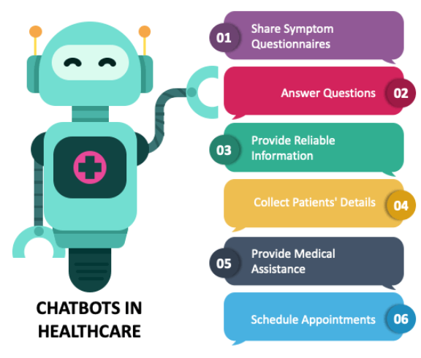
UNIQUENESS
RAG Architecture
Multilingual Support
AR / VR Interface
Remainder System for tablets, checkups, etc.
Call Support for Bookings and Medical Enquires

Slide 9
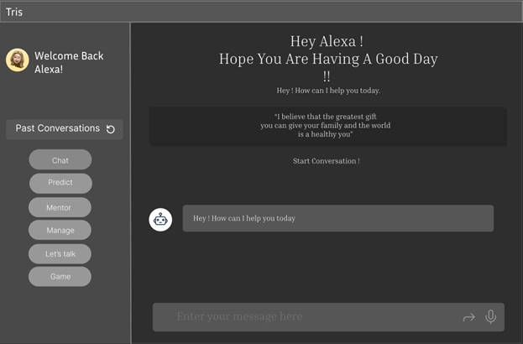
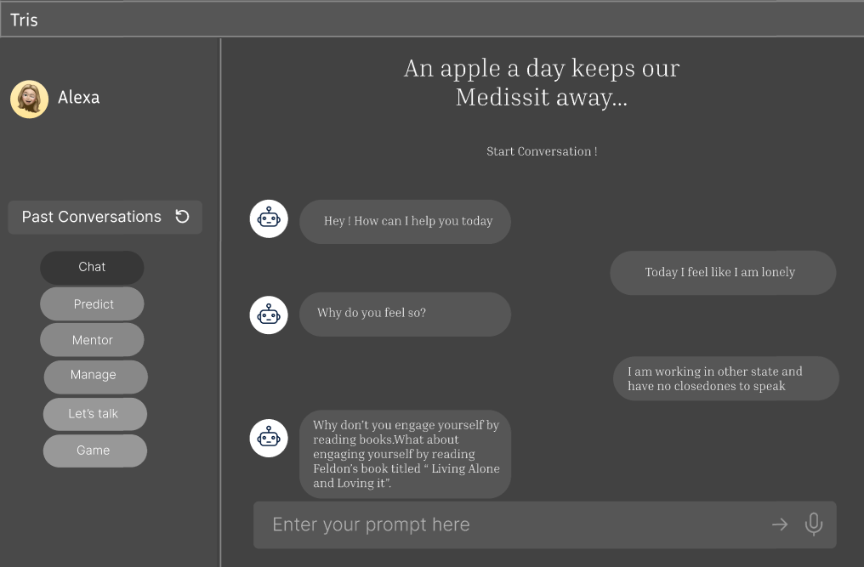

Slide 10
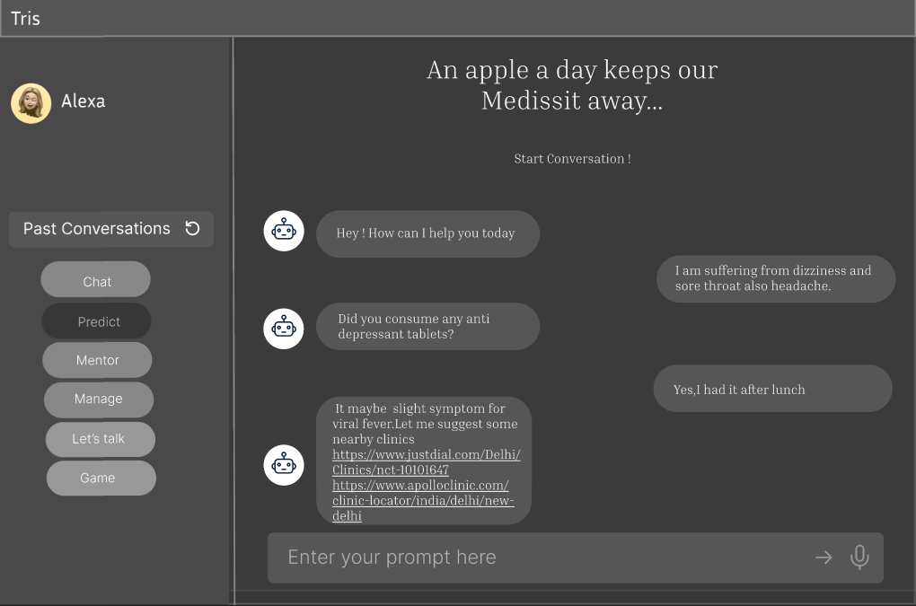
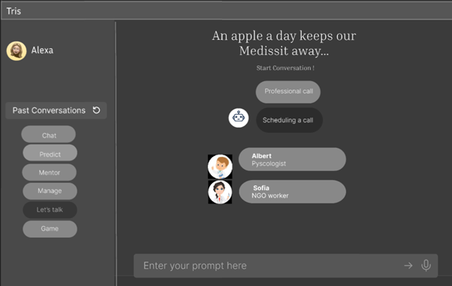

Slide 11
PROTOTYPES
As our proposed solution is currently in initial phase, these are some of the sample visuals we had made to present our idea :
Modal Design link :
https://www.figma.com/file/DlFdkHeILymC8KfmJOH7BT/Untitled-(Copy)?type=design&node-id=0%3A1&mode=design&t=O5zVtuZJVHV45Ro8-1
Ar Animation video link :
https://drive.google.com/file/d/12qUixb7Sm8pLA8Hy7KNGNiUun4PZGm3U/view?usp=sharing
Sample images link :
https://docs.google.com/document/d/1TSclkfGQEH92ESrMrNASK4-7RtZNGVz0/edit?usp=sharing&ouid=107278125563018955496&rtpof=true&sd=true

Slide 12
THANK YOU

